Slide 1
Represent PID relation by graph
2021-03-18
4th grade
Jaeho Jeon

Slide 2
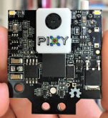
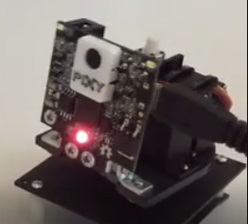
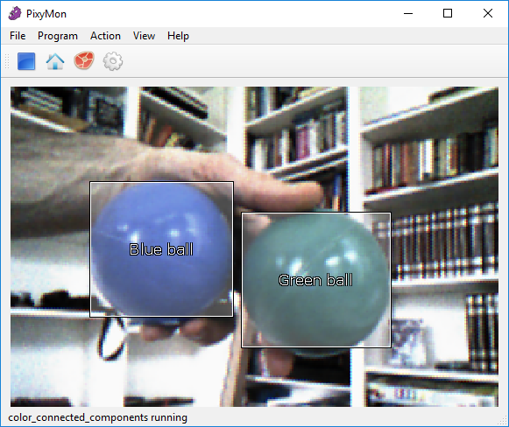
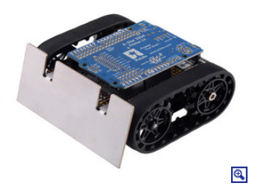
relation
panOffset(x axis)
Pan-Loop
panLoop.m_command
tiltOffset(y axis)
Tilt-Loop
tiltLoop.m_command
rotateOffset(left or right)
transOffset(height)
Rotate-Loop
rotateLoop.m_command
panOffset = (int32_t)pixy.frameWidth/2 - (int32_t)block->m_x;
transLoop.m_command
tiltOffset = (int32_t)block->m_y - (int32_t)pixy.frameHeight/2;
Trans-Loop
rotateOffset = panOffset + panLoop.m_command - CENTER_POS;
transOffset = tiltOffset + tiltLoop.m_command + CENTER_POS
left = -rotateLoop.m_command + translateLoop.m_command;
right = rotateLoop.m_command + translateLoop.m_command

Slide 3
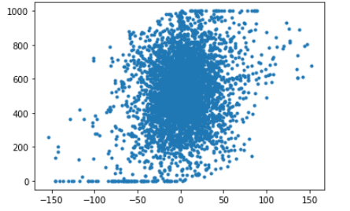
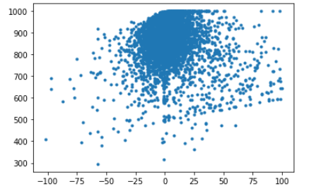
프로젝트 제목
Camera x axis
Camera y axis
panOffset
Pan-Loop
panLoop.m_command
tiltOffset
Tilt-Loop
tiltLoop.m_command
tiltLoop.m_command
panLoop.m_command
panOffset(x axis)
tiltOffset(y axis)
panOffset = (int32_t)pixy.frameWidth/2 - (int32_t)block->m_x;
tiltOffset = (int32_t)block->m_y - (int32_t)pixy.frameHeight/2;

Slide 4
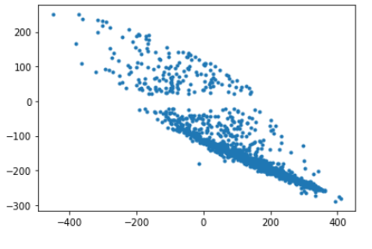
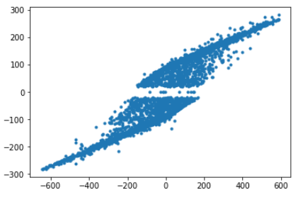
프로젝트 제목
Mediate motor about height
Control motor left or right
transOffset
Trans-Loop
transLoop.m_command
rotateOffset
rotateLoop.m_command
Rotate-Loop
transLoop.m_command
rotateLoop.m_command
transOffset
rotateOffset
transOffset = tiltOffset + tiltLoop.m_command + CENTER_POS
rotateOffset = panOffset + panLoop.m_command - CENTER_POS;
left = -rotateLoop.m_command + translateLoop.m_command;
right = rotateLoop.m_command + translateLoop.m_command

